Slide 1
The Stolen Child- William Yeats
Lesson 1-

Slide 2
Riddles
I’m often running yet I have no legs. You need me but I don’t need you. What am I?
A man was taking a walk and it started to rain. He did not bring an umbrella or wear a hat. All of his clothes got wet but not a single hair got wet. How is this possible?
What has keys but no locks, Space but no room, You can enter but you can’t exit.

Slide 3
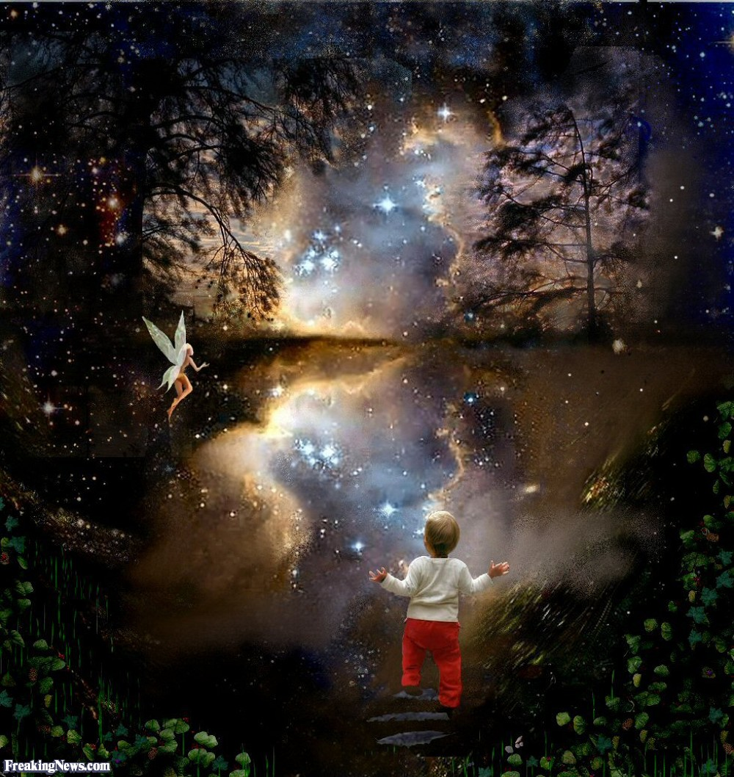
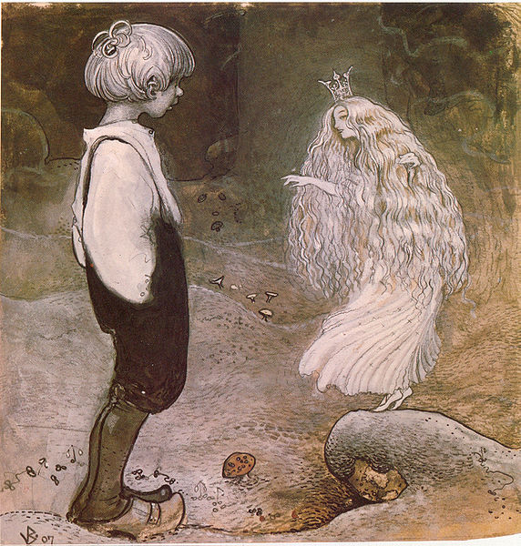
Starter: Visual Literacy
Write 2-3 sentences to describe what you think is happening in each picture

Slide 4
Objectives
Procedural: Annotate and analyze themes, poetic devices and meaning in The Stolen Child
Declarative: I can understand and identify the context of a poem, its meaning and literary devices

Slide 5
William Yeats
William Butler Yeats was an Irish poet and one of the foremost figures of 20th-century literature.
William Yeats’s early poems were Odes to the beauty and mystery of the Irish countryside
William Yeats poems are known for their ‘lyrical’, ‘musical’ and ‘mythological’ qualities
His poem, “The Stolen Child” is a poem about the Irish mythology of fairies who steal children away from their families and homes

Slide 6
Summary of the poem
Context:
  The poem was written in 1896 and first published in the Irish Monthly in 1889
Meaning/cultural significance:
  In Irish culture and folklore, fairies were considered to be somewhat ‘evil’ creatures.
Summary:
  The poem “Stolen Child” is about a young boy who led away by the temptation of the fairies.
  Land of the fairies represents an ‘escape’ from the human world of suffering

Slide 7

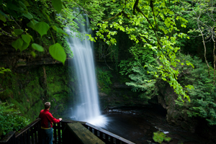
Setting
Setting: Poem is set in the beautiful, bright landscape of Co Sligo highlands. Poem’s setting reflects the element of LIGHT- beauty, innocence, purity)

Slide 8
What words come to your mind when you see these pictures?
Describe the words/images that come to your mind

Slide 9
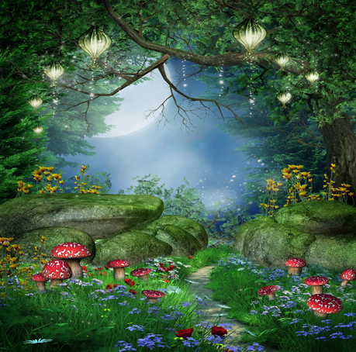
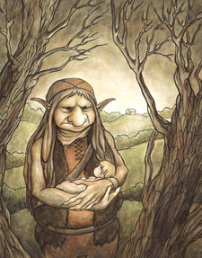
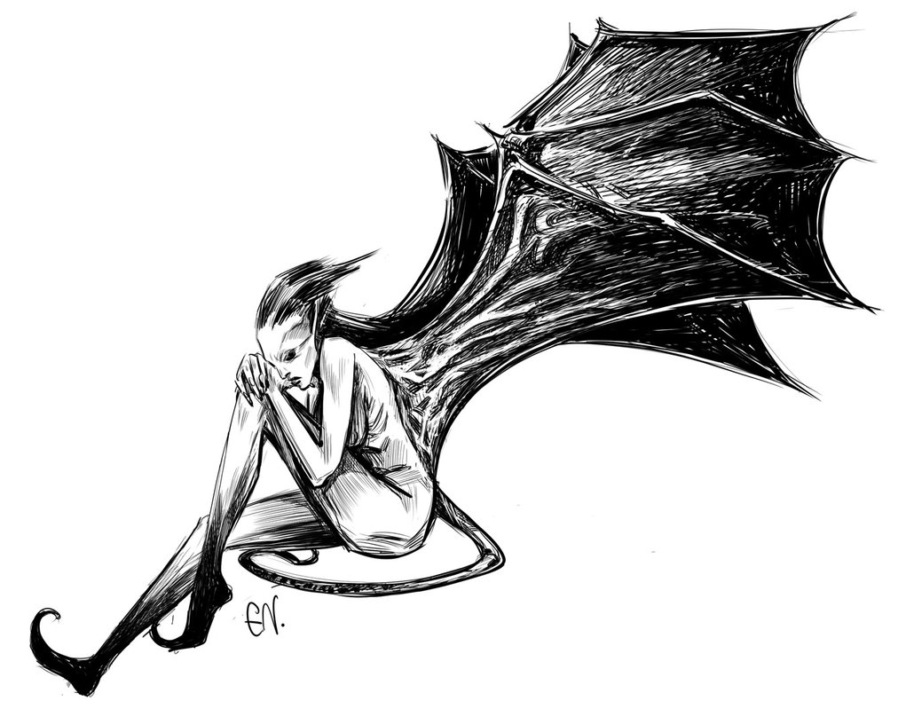
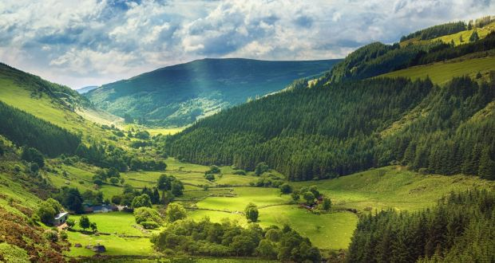
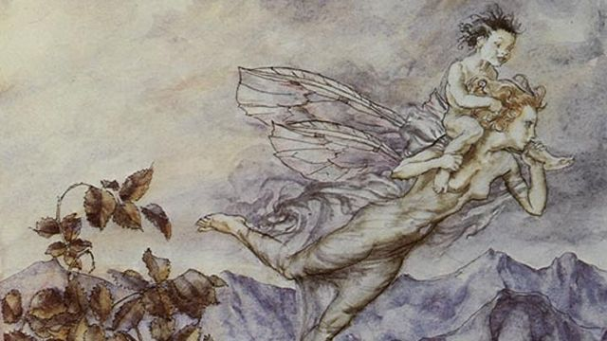

Slide 10
Summary of the poem
Key Themes:
Light:
The setting reflects purity and beauty
The child in the poem represents light through his childhood:
Naivety, curiosity and wonder of the world
Dark:
The ‘human world’ represents the darkness in the poem.
The darkness refers to the sorrow in the human world;
Yeats could be referring to the war in which many Irish people lost their identity and lives.
The fairies can reflect either Light or Dark (depending on how you interpret the poem).
Light as they can be interpreted as trying to help the boy by taking him away from the ‘sorrowful’ world.
Dark as they have no right to encourage the child to leave behind his home, parents and his world

Slide 11
How does this reflect reality?
How does this reflect reality?:
Consider how the poem reflects the human desire to ‘escape’ the painful realities that we sometimes live in. How many of you consider ‘running away’ or escaping your troubles?
The Stolen Child reflects our human desire to enter a ‘fantasy world’ to escape our fears

Slide 12
What ‘reality’ do you think the poem could be talking about?
War
Grief
Human Suffering
Death
Depression

Slide 13
Vocabulary Dictionary
Word | Meaning
Sleuth Wood | Forest/Woodland located in Sligo, Ireland
Herons | Birds with long necks, legs and bills, living along riverbanks and marshes
Faery (Fairy) | A fairy is a type of mythical being or legendary creature in European folklore
Vats | A large tank or tub
Glosses | Shines
Rosses | Marshes (Swamp)
Glen Car | Area of wild mountain scenery
Slumbering | Sleeping
Solemn | Sad, Serious
Hob | Shelf on a fireplace used to keep things warm

Slide 14
Listening to a reading of the poem
Highlight the words from the vocabulary dictionary as you hear them being read in the poem
https://www.youtube.com/watch?v=g9hnUYV06t4

Slide 15
Brain Break: 5 minutes
https://www.youtube.com/watch?v=Nv5NhPDUtXY&t=0s&index=188&list=PLVNocu2A1SABPv0mzrHVzHk0L8I-A6s-N

Slide 16
Activity: Examining the moral in the story
The story is about the boy being led away from the human world to the ‘tempting’ world of the fairies. Completing this activity will help you understand the moral themes in the text.
The Child Why do you think the child believes the fairies? Is it possible the child is suffering from some kind of hardship? Do you think the child is mature enough to understand the consequences of what he is doing? Have the fairies taken advantage of the child’s age? | The Fairies Why is it selfish of the fairies to take the boy away? Why do you think the fairies are making all these promises to the child? Do you think ‘fairy land’ is actually better than the human world? Is it ever okay to take a child away from it’s parents?

Slide 17
Summary Reflection:
What is good and evil about the intentions of the fairies in this poem?
Explain how William Yeats warns us about the temptation to ‘escape’ to a fantasy world. What is the moral of the poem?

Slide 19
Lesson 2- Annotation of the Poem

Slide 20
Start Annotating the Poem
Setting:
Imagery:
Rhyme:
Themes: Light has been represented by positive imagery; Light, Goodness, Harmony/Peace
Atmosphere: Full of light and goodness, (‘heaven’ or the ‘Garden of Eden’)
What is happening:
Describing their magical land full of animals, beautiful fruits (berries).
Fairies are encouraging the human child to come away
Where dips the rocky highland
Of Sleuth Wood in the lake,
There lies a leafy island
Where flapping herons wake
The drowsy water-rats;
There we’ve hid our faery vats,
Full of berries
And of reddest stolen cherries.
Come away, O human child!
To the waters and the wild
With a faery, hand in hand,
For the world’s more full of weeping than you can understand.

Slide 21
Where the wave of moonlight glosses
The dim grey sands with light,
Far off by furthest Rosses
We foot it all the night,
Weaving olden dances,
Mingling hands and mingling glances
Till the moon has taken flight;
To and fro we leap
And chase the frothy bubbles,
While the world is full of troubles
And is anxious in its sleep.
Come away, O human child!
To the waters and the wild
With a faery, hand in hand,
For the world’s more full of weeping than you can understand.
What is happening in the poem:
Repetition:
Atmosphere/Imagery:
Positive/light-hearted
Describing the glory and fun waiting
Providing a contrast to the world ‘full of weeping’
Creates a sense of happiness

Slide 22
Where the wandering water gushes
From the hills about Glen-Car,
In pools among the rushes
That scarce could bathe a star,
We seek for slumbering trout
And whispering in their ears
Give them unquiet dreams;
Leaning softly out
From ferns that drop their tears
Over the young streams.
Come away, O human child!
To the waters and the wild
With a faery, hand in hand,
For the world’s more full of weeping than you can understand.
Alliteration:
Imagery: ‘hills about Glen-Car’, ‘pools among the rushes
Personification:
Atmosphere:
Bright, happy mood of the text suddenly becomes a bit darker (‘unquiet dreams’, ‘tears’)
Suggests fairies may posses some evil qualities in them (Theme of DARK)

Slide 23
Away with us he’s going,
The solemn-eyed:
He’ll hear no more the lowing
Of the calves on the warm hillside
Or the kettle in the hob
Sing peace into his breast,
Or see the brown mice bob
Round and round the oatmeal-chest.
For he comes, the human child,
To the waters and the wild
With a faery, hand in hand,
From a world more full of weeping than he can understand.
What is happening in the scene:
Imagery:
Rhyme:
Atmosphere:
Dark and suspenseful
Theme:
Fairies have promised to bring boy to a place full of ‘light’ and ‘goodness’
Darkness- Boy has unknowingly been taken away from family and home.

Slide 24
Stolen Child Exemplar Essay- A Standard
Identify PEEL in each paragraph
POINT
EVIDENCE
ELABORATION
LINK
Underline the examples of Analytical Vocabulary in the Exemplar

Slide 25
Catch-up Time: Copy down any notes you have missing

Slide 26
Movie:

