Slide 1
Porphyria’s Lover by Robert Browning
Week 3

Slide 2
Can you unscramble the words
TUSRUCTER
EMNAIGN
IAMEGRY
LNGAUAGE
ECFETF

Slide 3
Starter: Copy this text
Dramatic monologues feature a solitary speaker addressing at least one silent, usually unnamed person, and they provide interesting snapshots of the speakers and their personalities. Unlike soliloquies, in dramatic monologues the characters are always speaking directly to listeners. Browning’s characters are usually crafty, intelligent, argumentative, and capable of lying. Indeed, they often leave out more of a story than they actually tell. In order to fully understand the speakers and their psychologies, readers must carefully pay attention to word choice, to logical progression, and to the use of Figures Of Speech, including any Metaphors or analogies. For instance, the speaker of “My Last Duchess” essentially confesses to murdering his wife, even though he never expresses his guilt outright.

Slide 4
Objectives
• Identify the language features and themes in Porphyria’s lover
• I can understand the features of the SMIILE framework

Slide 5
What is the SMILE template
SMILE is the name of the template that you have been asked to use in your exam
The SMILE template is a grid the helps you identify the important elements for your exam
For every poem we look at, we will complete a SMILE analysis

Slide 6
Structure | How many stanzas/verses? What words/phrases emphasise the images or themes? Are there words and/or lines repeated? What is the line length/rhyme scheme?
Meaning | What is the poem about? Does it have a message? What is the poet discussing? Is there an overall theme and idea in the poem?
Imagery | What pictures do you get in your mind when you read the poem? Does the poem contain similes, metaphors or personification? Why do you think the poet has included these images?
Language | What words have been used to create images? Are there any complicated words? Is the language simple to understand? Which words and phrases create the images? What adjectives are included? Colour, size, comparison?
Effect | What is the effect of the poem? What does the poem make you think or feel about? What is the poet trying to say about their subject?

Slide 7
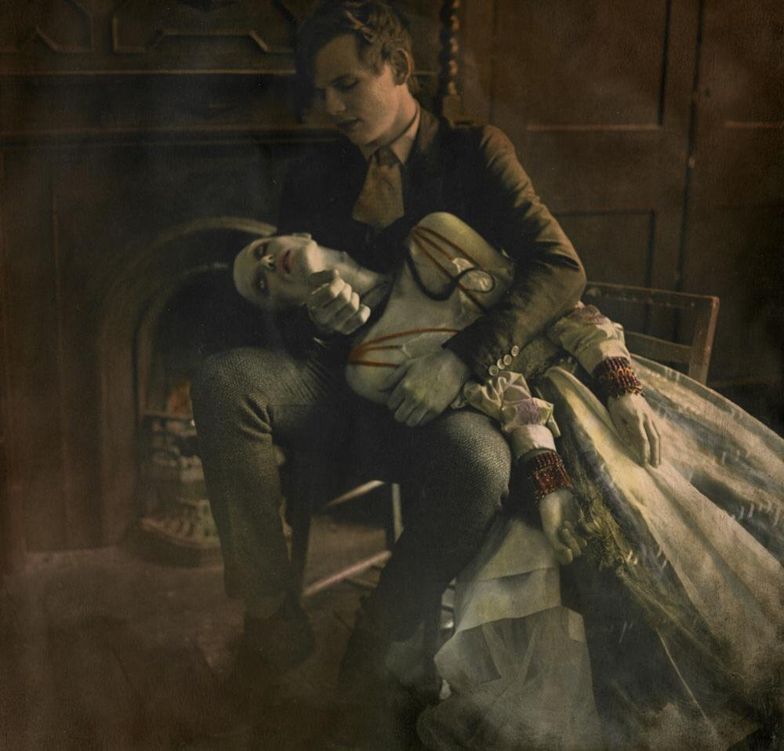
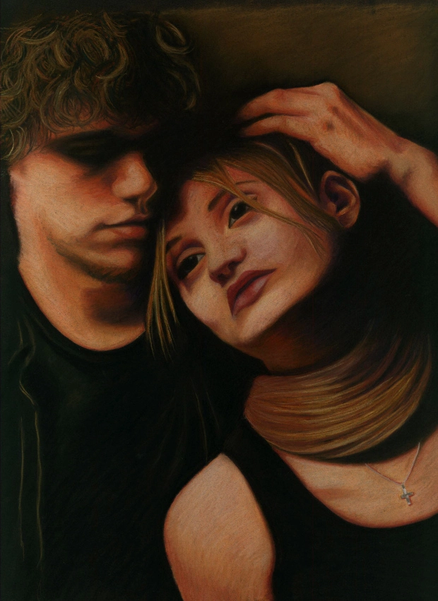

Slide 8
Turn to page 30-32 of your anthology
On the blank copy of the poem, take the following notes:
Context of the poem: Victorian Era, written by Robert Browning in 1836
Intro: Poem is about a mad man who murders his lover Porphyria for some unknown reason. He waits for her to arrive at his cottage, where he spurns her love and strangles her with her own hair. He then sits and contemplates his success in killing her. He feels as if he has successfully ‘kept her’ for himself.
Reality represented: Jealousy, madness, greed, selfishness, obsessive love, desire to control
Themes: Death, Madness, Darkness, Evil

Slide 9
Porphyria’s Dictionary
Word in the poem | Meaning in context
sullen | miserable, gloomy
vex | annoy, upset
grate | fireplace
endeavour | effort, attempt
vainer | worldly
dissever | cut off
prevail | win
warily | cautiously
tress | strand of hair
scorned | despised
oped | opened
utmost will | greatest wish

Slide 10
Porphyria’s Lover by Robert Browning
Imagery: Rain, Night, Angry wind, Violence – sets the ‘dark tone’ from the poem
Personification: ‘sullen wind’- given negative human feelings to an object
Atmosphere: Gloomy and Dark (foreboding)
Rhyme: Author uses Rhyme to give the poem a ‘flow’ effect
Scene: Porphyria arrives; brings light and warmth to the cottage
(Representation of Light and warmth- tone of the poem is more positive)
The rain set early in to-night
The sullen wind was soon awake,
It tore the elm-tops down for spite,
And did its worst to vex the lake:
I listened with heart fit to break.
When glided in Porphyria; straight
She shut the cold out and the storm,
And kneeled and made the cheerless grate
Blaze up, and all the cottage warm;
Which done, she rose, and from her form
Withdrew the dripping cloak and shawl,
And laid her soiled gloves by, untied
Her hat and let the damp hair fall,

Slide 11
And, last, she sat down by my side
And called me. When no voice replied,
She put my arm about her waist,
And made her smooth white shoulder bare,
And all her yellow hair displaced,
And, stooping, made my cheek lie there,
And spread, o'er all, her yellow hair,
Murmuring how she loved me — she
Too weak, for all her heart's endeavour,
To set its struggling passion free
From pride, and vainer ties dissever,
And give herself to me for ever.
‘No voice replied’- (sense of cruelty- Man does not bother to show affection)
Imagery: emphasizes Porphyria’s beauty and goodness (she confesses her love for him)
Theme:
Man considers Porphyria to be ‘weak’ and emotional.
In comparison he feels strong and powerful
The man’s dark obsession to posses and dominate her appear in the text. DARK vs LIGHT

Slide 12
But passion sometimes would prevail,
Nor could to-night's gay feast restrain
A sudden thought of one so pale
For love of her, and all in vain:
So, she was come through wind and rain.
Be sure I looked up at her eyes
Happy and proud; at last I knew
Porphyria worshipped me; surprise
Made my heart swell, and still it grew
While I debated what to do.
Imagery/emotive language: passion, heart swell, happy and proud
Scene:
The man talks about how Porphyria left ‘to-night’s gay feast’ (party) and came through wind and rain to come and see him.
Theme:
He see’s how ‘happy and proud’ Porphyria is. Represents Love, Happiness (symbolism of Light)
Contrast with the darkness inside the man (symbolism of Darkness)
Mood:
Mood becomes dark and suspenseful

Slide 13
Brain Break:
Trivia

Slide 14
That moment she was mine, mine, fair,
Perfectly pure and good: I found
A thing to do, and all her hair
In one long yellow string I wound
Three times her little throat around,
And strangled her. No pain felt she;
I am quite sure she felt no pain.
As a shut bud that holds a bee,
I warily oped her lids: again
Laughed the blue eyes without a stain.
And I untightened next the tress
About her neck; her cheek once more
Blushed bright beneath my burning kiss:
I propped her head up as before,
Only, this time my shoulder bore
Her head, which droops upon it still:
The smiling rosy little head,
So glad it has its utmost will,
Language features:
Repetition: Mine, Mine
Metaphor: One Yellow String
Rhyme: wound, around
Simile: As a shut bud that holds a bee
Imagery:
Blushed bright
Burning kiss
Themes:
‘Perfectly pure and good’- Porphyria embodies Light
What has happened in the scene(use quotes)?
He has strangled her with her own hair

Slide 15
Reflection:
How confident are you now about your note-taking and analysis skills for the exam?
Homework:
Fill out as much of the SMILE template for Porphyria’s Lover before Friday

Slide 16
Porphyria’s lover
Lesson2

Slide 17
For each letter of the alphabet name a fruit or vegetable
How far can you get without getting stuck?
A=……, B=……., C=…….

Slide 18
Last 5 minutes:
https://missk.poetry.blog/

Slide 19
Finishing off the stanza from last lesson

Slide 20
What is happening:
He sits with her dead body feeling successful
“God has not said a word”- The man has not yet been punished by God for his actions.
Theme/message of the poem:
Dark vs Light; poem shows the darkness in obsessive love and desire for power
Reflects reality; abuse is a method to control and dominate
Mood:
Dark and grim (he has destroyed the Light/Happiness- symbolized by Porphyria)
That all it scorned at once is fled,
And I, its love, am gained instead!
Porphyria's love: she guessed not how
Her darling one wish would be heard.
And thus we sit together now,
And all night long we have not stirred,
And yet God has not said a word!

Slide 21
Starter: Copy this text
Starter: Copy This Text
“Porphyria’s Lover,” which first appeared in 1836, is one of the earliest and most shocking of Browning’s dramatic monologues. The speaker lives in a cottage in the countryside. His lover, a blooming young woman named Porphyria, comes in out of a storm and proceeds to make a fire and bring cheer to the cottage. She embraces the speaker, offering him her bare shoulder. He tells us that he does not speak to her. Instead, he says, she begins to tell him how she has momentarily overcome societal strictures to be with him. He realizes that she “worship[s]” him at this instant. Realizing that she will eventually give in to society’s pressures, and wanting to preserve the moment, he wraps her hair around her neck and strangles her. He then toys with her corpse, opening the eyes and propping the body up against his side. He sits with her body this way the entire night, the speaker remarking that God has not yet moved to punish him.

Slide 22
Objectives
Identify the language features and themes in Porphyria’s lover
I can understand the features of the analytical essay genre

Slide 23
ELEMENT | DEFINITION | ANALYSIS | EXAMPLE FROM POEM | Representation: Light vs Dark / Good vs Evil
Structure | What words/phrases emphasise the images or themes? What is the line length/rhyme scheme? | The structure creates a ‘story-like’ tone for the poem. The use of imagery helps to convey themes of Light vs Dark | Words such as ‘happy and bright’, ‘perfectly pure and good’ Alternating rhyme scheme, ‘night’ ‘spite’ | Porphyria’s character is described with positive language to embody the theme of LIGHT The man’s DARKNESS is shown when he vividly describes how she loves him but kills her instead
Meaning | What is the poem about? Is there an overall theme and idea in the poem? | Poem is about a man who kills his lover to ‘posses’ her The overall theme is ‘Dark vs Light” | ”I found a thing to do, and all her hair, in one long yellow string I wound Three times her little through around, And strangled her” | Darkness= the man’s selfish desire to murder her despite her faithful love for him Light= Porphyria's loyalty and love are symbolic of happiness The message here suggests that a desire to dominate leads to a deadly obsession.
Imagery | Does the poem contain similes, metaphors or personification? | The poet has used similes, metaphors and personification to describe the way he kills Porphyria He has also used them to convey the elements of light and dark | Simile: As a shut bud holds the bee Metaphor: One long yellow string Personification: Sullen wind ‘Perfectly Pure and Good” | The poet uses a mixture of language features to describe how Light and Dark is represented by the characters, setting/atmosphere Light vs Dark has been used to contrast feelings of Love, Loyalty, Happiness VS Selfishness, madness, obsession

Slide 24
DEFINITION | ANALYSIS | EXAMPLE FROM POEM | Representation: Light vs Dark / Good vs Evil
Language | Are there any complicated words? Which words and phrases create the images? | Specific words have been used to create the dark atmosphere/setting Powerful words such as ……………………………………………………………………………………………… |  | Light vs Dark is represented by the language features in the poem Porphyria is described in positive language The ‘darkness’ of the man’s thoughts reflect his madness and obsession to control Porphyria
Effect | What is the effect of the poem? What does the poem make you think or feel about? What is the poet trying to say about their subject? | The effect of the poem is to shock the reader The poem makes me think about…… The poem explores what happens when dark thoughts and desires manifest into action

Slide 25
Brain break 5 minutes
Silent ball
Rules:
No talking
No passing the ball back to the person who threw it to you
No moving
No dropping the ball

Slide 26
Analytical Essay writing- Handout
Introduction Paragraph:
  Introduces the Poem, Author
  Summarize the poem and what it’s about
  Introduce the topic/argument of the essay
  Provides an overview of what you will talk about in the essay
Body Paragraph: [USE PEEL]
  Has a topic sentence/point
  Uses evidence from the poem to explain the main point
  Elaborates on the evidence to explain its deeper meaning/significance (Link to reality)
  Last sentence of the body paragraph links back to the main exam question
Conclusion
    Recap of the essay and what main ideas you spoke about
    Explains how the essay explored the main exam question
    No new information

Slide 27
Vocabulary Table

Slide 28
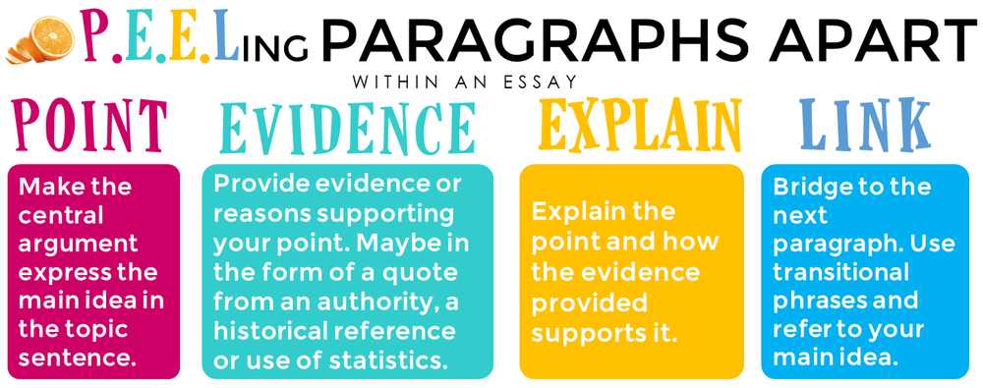
How do I write a good paragraph?
Follow PEEL

Slide 29
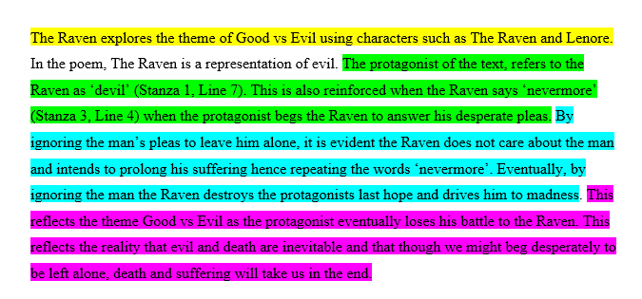
Look at the exemplar I gave you last lesson of a good paragraph/essay structure
You can clearly see the PEEL structure being applied!
Point of the paragraph identified
Evidence from the poem
Elaboration on the evidence- explaining what the evidence means
Linking the final sentence back to the exam task (proving how the characters reflect the themes

Slide 30
Have a go at writing a PEEL paragraph
Remember: Now you have your notes, SMILE template and examples to help you!
Question:
Explain how the poem Porphyria’s Lover by Robert Browning shows the theme of Darkness.

